Slide 1
NC architectures for solving Combinatorial Optimization Problems
A Compilation of past works 24.01.2023

Slide 2
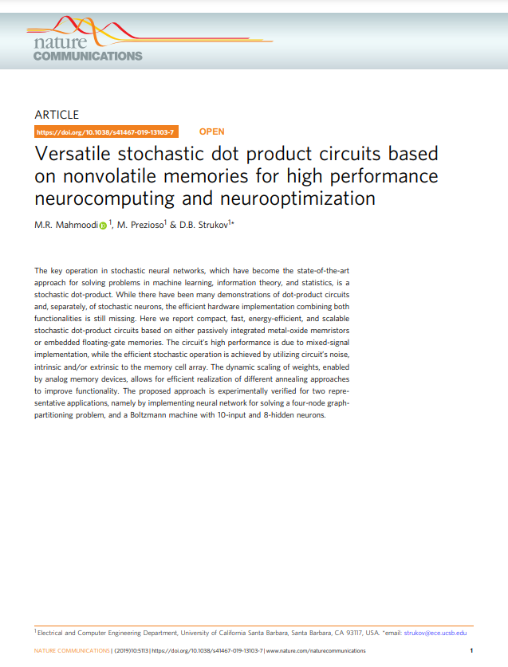
Versatile stochastic dot product circuits based on nonvolatile memories for high performance neurocomputing and neurooptimization
M.R. Mahmoodi, M. Prezioso & D.B. Strukov

Slide 3
Stochastic dot-product circuits
Compact, fast, energy-efficient hardware implementations providing a combination of both functionalities: dot-product circuits and stochastic neurons
Based on:
Metal-oxide memristors
Embedded floating-gate memories
Mixed signal implementation utilizing circuit’s noise (intrinsic/extrinsic) giving rise to high performance
High efficiency of various annealing approaches realized due to dynamic scaling of weights capability

Slide 4
Motivation and Prior Works
Why do we need a hardware to calculate dot-products?
Dot products are one of the most common mathematical operations in machine learning, statistics, signal/image processing, etc, but will more importantly be highly essential in neuromorphic applications.
Dot-product circuits speed up the calculation of vector-matrix multiplication, compared to a CPU.
Why is stochastic implementation necessary?
“Computations by brain are inherently stochastic.” Very low SNR of neuronal signals plays an important role in the brain’s functionality.
My reason: Solutions to NP-Complete problems cannot be obtained in polynomial time only by using deterministic algorithms. But randomized algorithms could lead to a polynomial time solution.
There are several other emerging hardware that are built with a focus on solving optimization problems. For e.g.:
nanomagnets
CMOS
Josephson Junction (Quantum Annealing)
Photonics
https://web.ece.ucsb.edu/~strukov/papers/2021/semicon2021.pdf

Slide 5
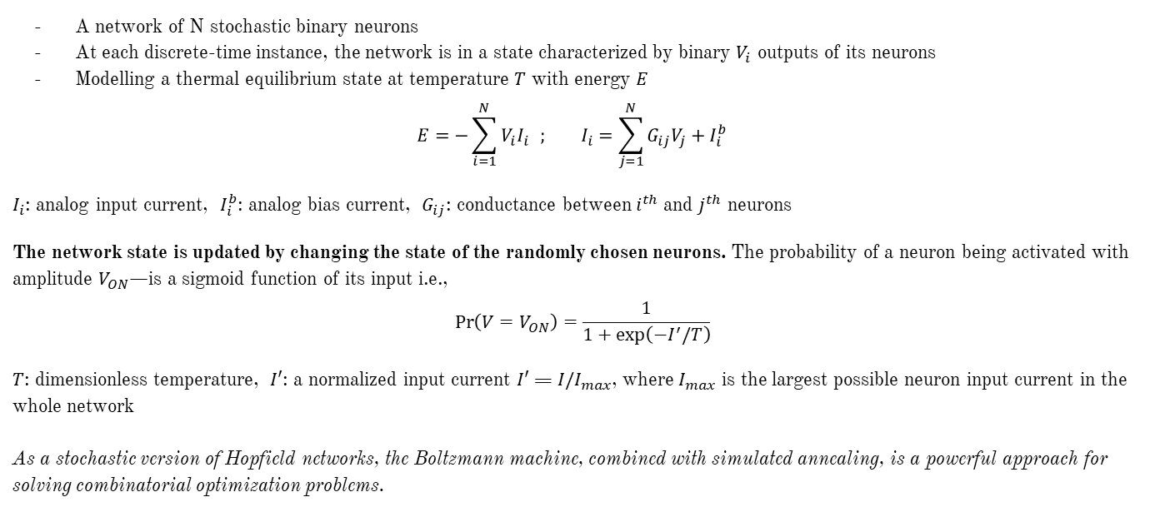
The idea behind a Boltzmann Machine
A network of N stochastic binary neurons
At each discrete-time instance, the network is in a state characterized by binary $V_{i}$ outputs of its neurons
Modelling a thermal equilibrium state at temperature $T$ with energy $E$
$$E=−\sum_{i=1}^{N}{V_{i}I_{i}} ; I_{i}=\sum_{j=1}^{N}{G_{ij}V_{j}+I_{i}^{b}}$$
$I_{i}$: analog input current, $I_{i}^{b}$: analog bias current, $G_{ij}$: conductance between $i^{th}$ and $j^{th}$ neurons
The network state is updated by changing the state of the randomly chosen neurons. The probability of a neuron being activated with amplitude $V_{ON}$—is a sigmoid function of its input i.e., $$\operatorname{Pr}\left(V=V_{ON}\right)=\frac{1}{1+\exp\left(−I^{′}/T\right)}$$
$T$: dimensionless temperature, $I′$: a normalized input current $I′$ = ${I/I}_{max}$, where $I_{max}$ is the largest possible neuron input current in the whole network As a stochastic version of Hopfield networks, the Boltzmann machine, combined with simulated annealing, is a powerful approach for solving combinatorial optimization problems.

Slide 6
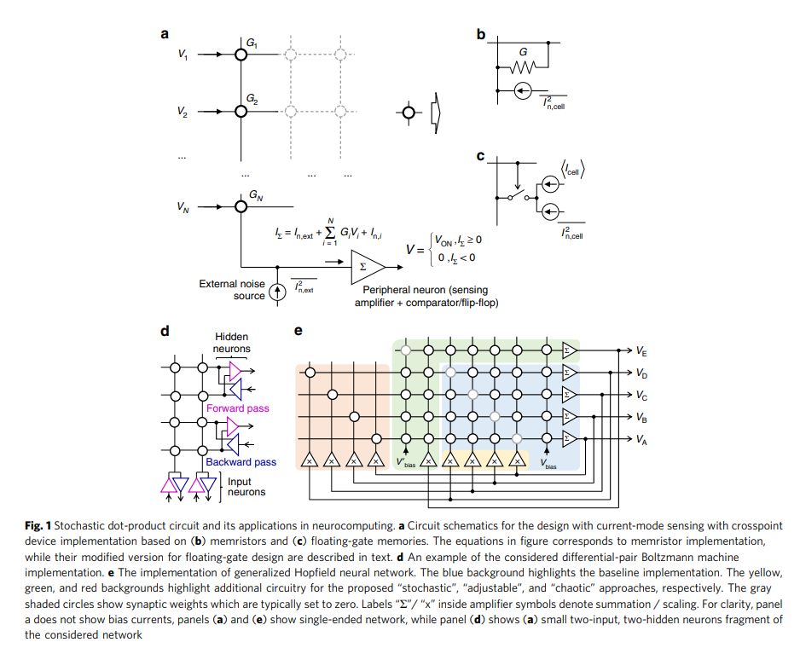

Slide 7
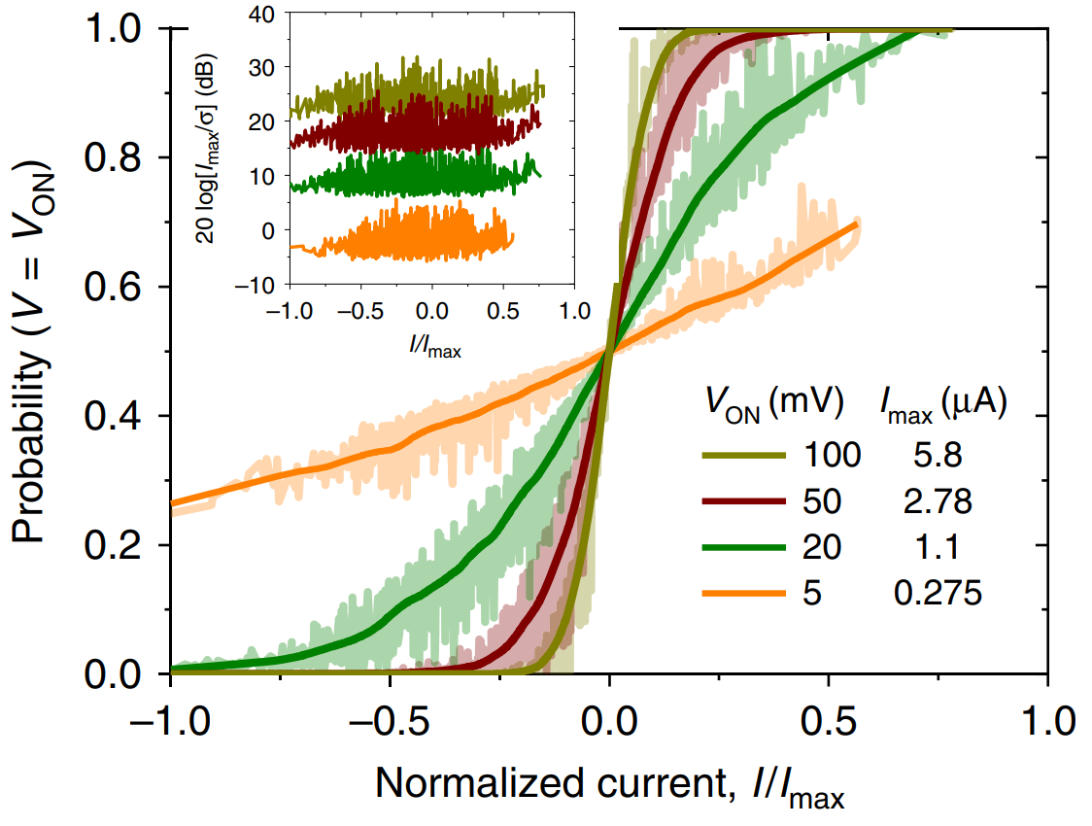
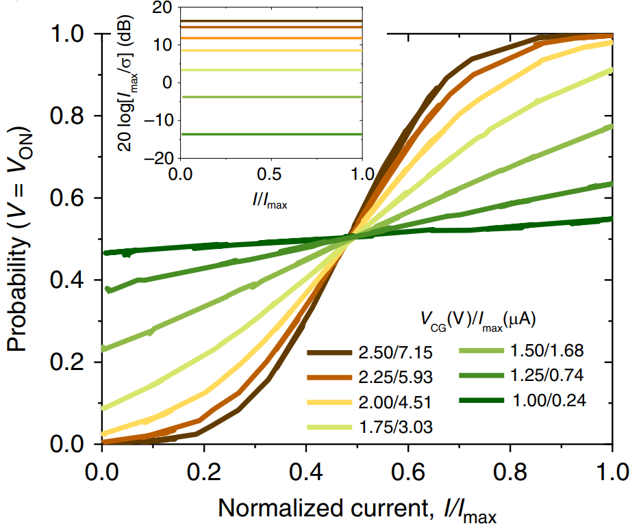
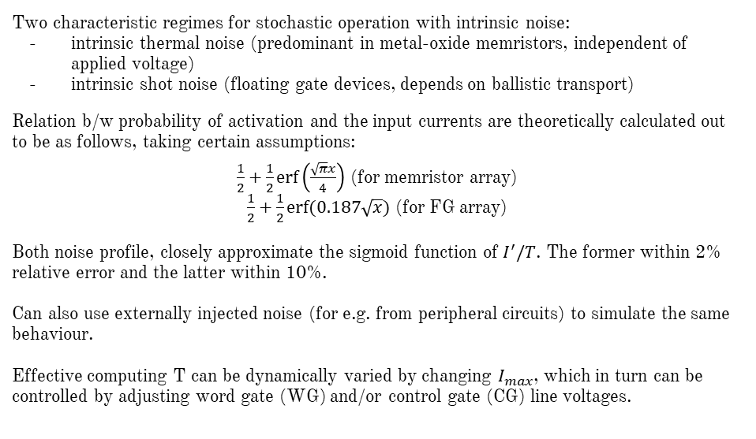
Noise Characterization and Working of Crossbar Memory Arrays
Two characteristic regimes for stochastic operation with intrinsic noise:
intrinsic thermal noise (predominant in metal-oxide memristors, independent of applied voltage)
intrinsic shot noise (floating gate devices, depends on ballistic transport)
Relation b/w probability of activation and the input currents are theoretically calculated out to be as follows, taking certain assumptions:
$\frac{1}{2}+\frac{1}{2}\operatorname{erf}\left(\frac{\sqrt{π}x}{4}\right)$ (for memristor array) $\frac{1}{2}+\frac{1}{2}erf⁡(0.187\sqrt{x})$ (for FG array)
Both noise profile, closely approximate the sigmoid function of $I^{′}/T$. The former within 2% relative error and the latter within 10%. Can also use externally injected noise (for e.g. from peripheral circuits) to simulate the same behaviour. Effective computing T can be dynamically varied by changing $I_{max}$, which in turn can be controlled by adjusting word gate (WG) and/or control gate (CG) line voltages.
Approximate sigmoidal behavior in a (Top: memristor-based, Bottom: floating-gate memory-based) stochastic neuron with external noise. The inset shows peak signal-to-noise ratios across full range of neuron’s input currents.

Slide 8
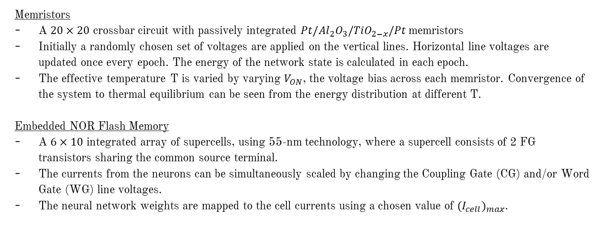
Operating the Boltzmann Machine
Memristors
A $20×20$ crossbar circuit with passively integrated $Pt/Al_{2}O_{3}/TiO_{2−x}/Pt$ memristors
Initially a randomly chosen set of voltages are applied on the vertical lines. Horizontal line voltages are updated once every epoch. The energy of the network state is calculated in each epoch.
The effective temperature T is varied by varying $V_{ON}$, the voltage bias across each memristor. Convergence of the system to thermal equilibrium can be seen from the energy distribution at different T.
Embedded NOR Flash Memory
A $6×10$ integrated array of supercells, using 55-nm technology, where a supercell consists of 2 FG transistors sharing the common source terminal.
The currents from the neurons can be simultaneously scaled by changing the Coupling Gate (CG) and/or Word Gate (WG) line voltages.
The neural network weights are mapped to the cell currents using a chosen value of ${(I_{cell})}_{max}$.

Slide 9
Demonstrating Versatility
Baseline
Adjustable Approach
Chaotic
Stochastic

Slide 10
<Steps for operation of the crossbar memory array> <Discussion and comparison of approaches: baseline, adjustable, chaotic, and stochastic> <Comparison of memory devices: Memristor and FG Devices>
How is the crosspoint array of neurons programmed? i.e. How are the conductance values fixed? Iterative process of applying voltages and in the forward pass and in the backward pass.
In the next step calculated voltages at the hidden neurons are applied to the horizontal lines and the new voltages at the input neurons are calculated. After every update of the overall network state, an epoch is finished and the corresponding energy is evaluated. Where exactly is the voltage measured?
Synaptic/edge weight controlled with VWG.
Frequency of updating ~ bandwidth?
Baseline, Adjustable, Chaotic – Deterministic (High SNR)
Controlling T (Imax) with VCG

Slide 11
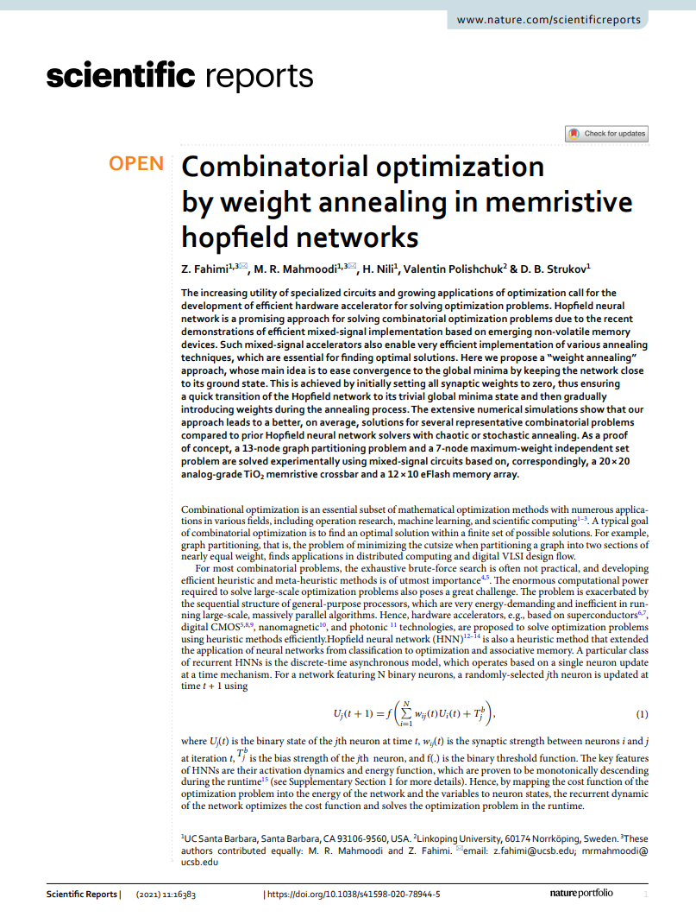
Combinatorial Optimization by weight annealing in memristive Hopfield networks
Z. Fahimi, M.R. Mahmoodi, H. Nili, Valentin Polishchuk & D.B. Strukov

Slide 12
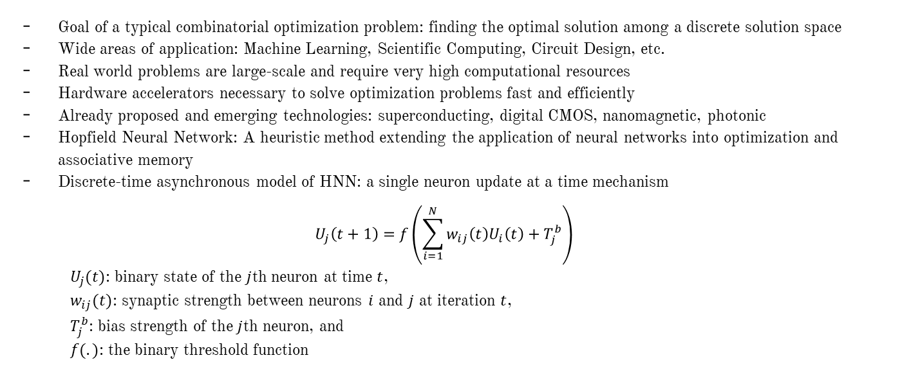
Hardware Accelerators for Combinatorial Optimization
Goal of a typical combinatorial optimization problem: finding the optimal solution among a discrete solution space
Wide areas of application: Machine Learning, Scientific Computing, Circuit Design, etc.
Real world problems are large-scale and require very high computational resources
Hardware accelerators necessary to solve optimization problems fast and efficiently
Already proposed and emerging technologies: superconducting, digital CMOS, nanomagnetic, photonic
Hopfield Neural Network: A heuristic method extending the application of neural networks into optimization and associative memory
Discrete-time asynchronous model of HNN: a single neuron update at a time mechanism
$$U_{j}\left(t+1\right)=f\left(\sum_{i=1}^{N}{w_{ij}\left(t\right)U_{i}\left(t\right)+T_{j}^{b}}\right)$$
$U_{j}(t)$: binary state of the $j$th neuron at time $t$,
$w_{ij}(t)$: synaptic strength between neurons $i$ and $j$ at iteration $t$,
$T_{j}^{b}$: bias strength of the $j$th neuron, and
$f(.)$: the binary threshold function

Slide 13
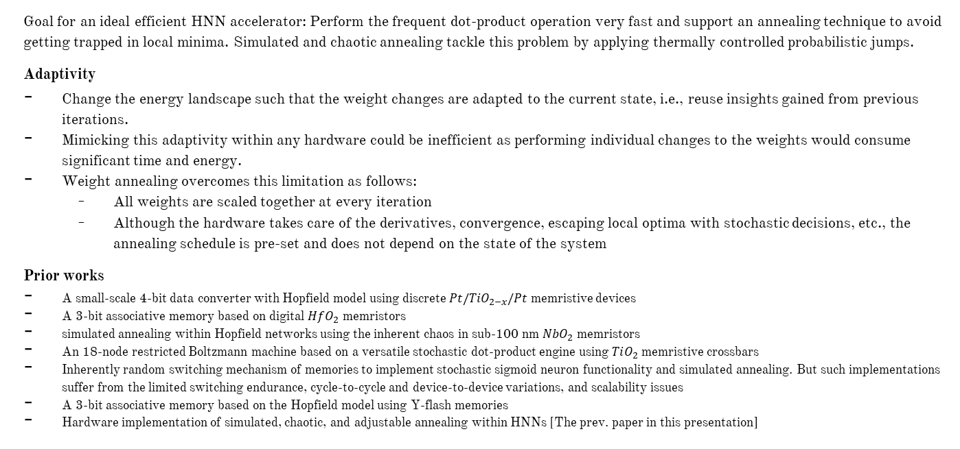
Motivation and Prior Works
Goal for an ideal efficient HNN accelerator: Perform the frequent dot-product operation very fast and support an annealing technique to avoid getting trapped in local minima. Simulated and chaotic annealing tackle this problem by applying thermally controlled probabilistic jumps.
Adaptivity
Change the energy landscape such that the weight changes are adapted to the current state, i.e., reuse insights gained from previous iterations.
Mimicking this adaptivity within any hardware could be inefficient as performing individual changes to the weights would consume significant time and energy.
Weight annealing overcomes this limitation as follows:
All weights are scaled together at every iteration
Although the hardware takes care of the derivatives, convergence, escaping local optima with stochastic decisions, etc., the annealing schedule is pre-set and does not depend on the state of the system
Prior works
A small-scale 4-bit data converter with Hopfield model using discrete $Pt/TiO_{2−x}/Pt$ memristive devices
A 3-bit associative memory based on digital $HfO_{2}$ memristors
simulated annealing within Hopfield networks using the inherent chaos in sub-100 nm $NbO_{2}$ memristors
An 18-node restricted Boltzmann machine based on a versatile stochastic dot-product engine using $TiO_{2}$ memristive crossbars
Inherently random switching mechanism of memories to implement stochastic sigmoid neuron functionality and simulated annealing. But such implementations suffer from the limited switching endurance, cycle-to-cycle and device-to-device variations, and scalability issues
A 3-bit associative memory based on the Hopfield model using Y-flash memories
Hardware implementation of simulated, chaotic, and adjustable annealing within HNNs [The prev. paper in this presentation]

Slide 14
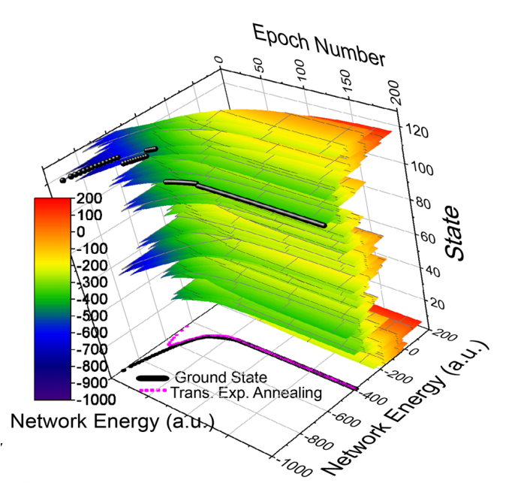
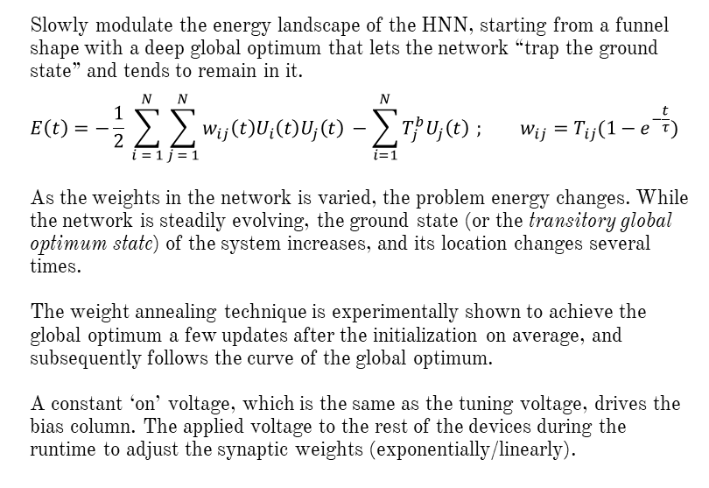
Weight Annealing
Slowly modulate the energy landscape of the HNN, starting from a funnel shape with a deep global optimum that lets the network “trap the ground state” and tends to remain in it.
$$E\left(t\right)=−\frac{1}{2} \sum_{i = 1}^{N}{\sum_{j = 1}^{N}{w_{ij}\left(t\right)U_{i}\left(t\right)U_{j}\left(t\right)}} −\sum_{i=1}^{N}{T_{j}^{b}U_{j}\left(t\right)} ; w_{ij}=T_{ij}(1−e^{−\frac{t}{τ}})$$
As the weights in the network is varied, the problem energy changes. While the network is steadily evolving, the ground state (or the transitory global optimum state) of the system increases, and its location changes several times.
The weight annealing technique is experimentally shown to achieve the global optimum a few updates after the initialization on average, and subsequently follows the curve of the global optimum.
A constant ‘on’ voltage, which is the same as the tuning voltage, drives the bias column. The applied voltage to the rest of the devices during the runtime to adjust the synaptic weights (exponentially/linearly).
The energy evolution of each state during weight annealing for 200 epochs and τ = 40. The black curve marks the transitory ground state of the system. The magenta curve shows the average transitory energy over 128 runs.

Slide 15
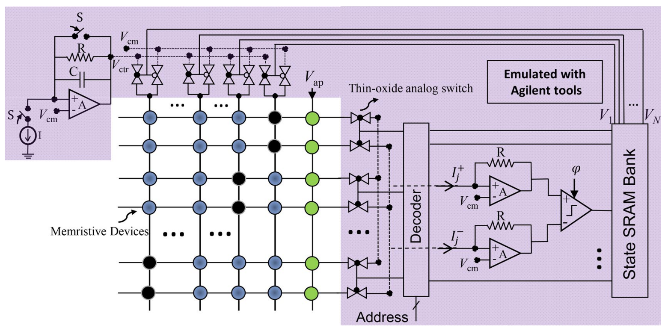
Implementation of Weight Annealing
Values R, C, and I depend on the problem size and technology, and determine the annealing schedule. Switch S resets the network to the initial condition. The selected neuron is determined by the input address to the decoder, and the operation is synchronized with the sampling clock (ϕ) in dynamic comparator

Slide 16
Using a control circuit for all the memory elements helps scale all synaptic weights simultaneously
Vctrl is exponentially increased toward Vap at which all devices are tuned
The post-synaptic circuits include trivial circuits:
a transimpedance amplifiers that senses currents,
a dynamic voltage comparator that updates the selected neuron state

Slide 17
A critical shortcoming of Hopfield networks that is also common to the Ising model and other greedy and local search methods is the presence of local minima in their energy function
Weight annealing, similar to the adjustable technique in the previously discussed paper, relies on dynamic scaling of the energy during runtime but with more straightforward implementation as it does not require extra circuitry, is not limited to the dynamic range of devices, and can be generally applied to any HNN irrespective of the target optimization problem

Slide 18
Why such a small problem size for a proof-of-concept implementation?
Mapping variables to neuron states?
Start looking at a problem and its formulation so it can help get the idea of its neural network implementation.
“The annealing schedule is preset.”
“The hardware takes care of the derivatives, convergence, escaping local optima with stochastic decisions, etc.”

